Slide 1
OHDSI Tutorial: Additional exercise from making cohorts to predict results
Jaehyeong Cho

Slide 2
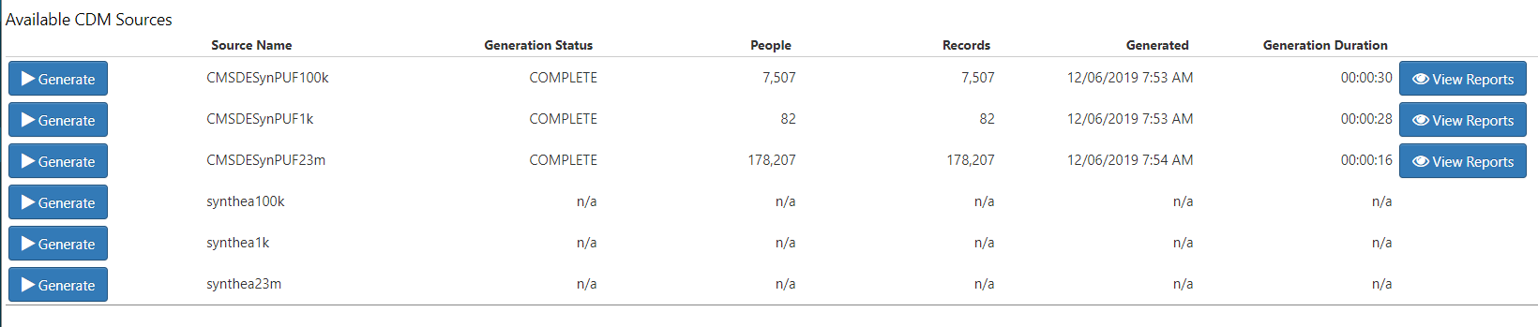

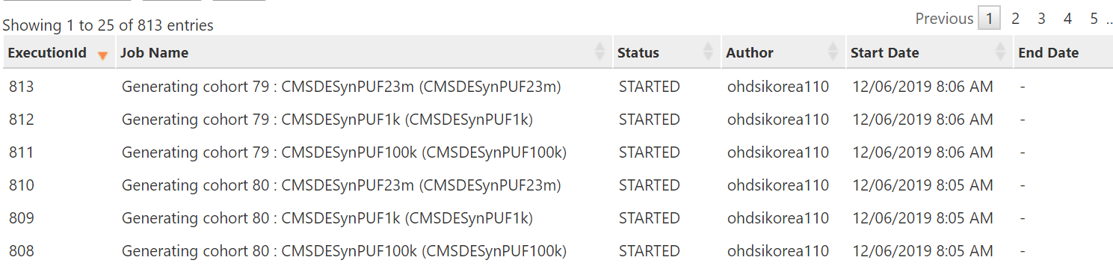
시작하기에 앞서
실습동안 SynPUF23m 에 대해서 Generate 누르지 말아주세요!
Synthea는 원 데이터가 좋지 않습니다. 사용하지 않기를 권합니다.

Slide 3
You can access to the whole stuff at
https://github.com/ ohdsi-korea/ OhdsiKoreaTutorials

Slide 4
Prediction problem
Choice | Value
Target population | 예측을 하고자 하는 대상 환자군
Outcome | 예측하고자 하는 임상적인 결과
Time At Risk (TAR) | 예측 모델을 적용시키고자 하는 환자군에게서 예측하고자 하는 임상 결과를 관찰 할 시간 구간
Model | 사용하고자 하는 예측 모델 알고리즘

Slide 5
Prediction problem
Choice | Value
Target population | Sulfonylurea 복용을 시작한 당뇨병 환자군
Outcome | Hypoglycemia 발생 환자군
Time At Risk (TAR) | 90일, 180일
Model | LASSO logistic regression

Slide 6
Target cohort
Choice | Value
Target population | Sulfonylurea 복용을 시작한 당뇨병 환자군
Outcome | Hypoglycemia 발생 환자군
Time At Risk (TAR) | 90일, 180일
Model | LASSO logistic regression
Sulfonylurea new user
Observation period 365 days was needed
Patient with T2DM
Patient who did not use other glucose lowering drugs
If sulfonylurea were stopped, cohort ended
If other glucose lowering drugs were prescribed, cohort censored

Slide 7
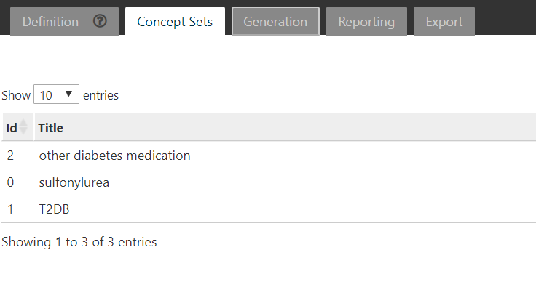
Before start: Making Concept Sets

Slide 8
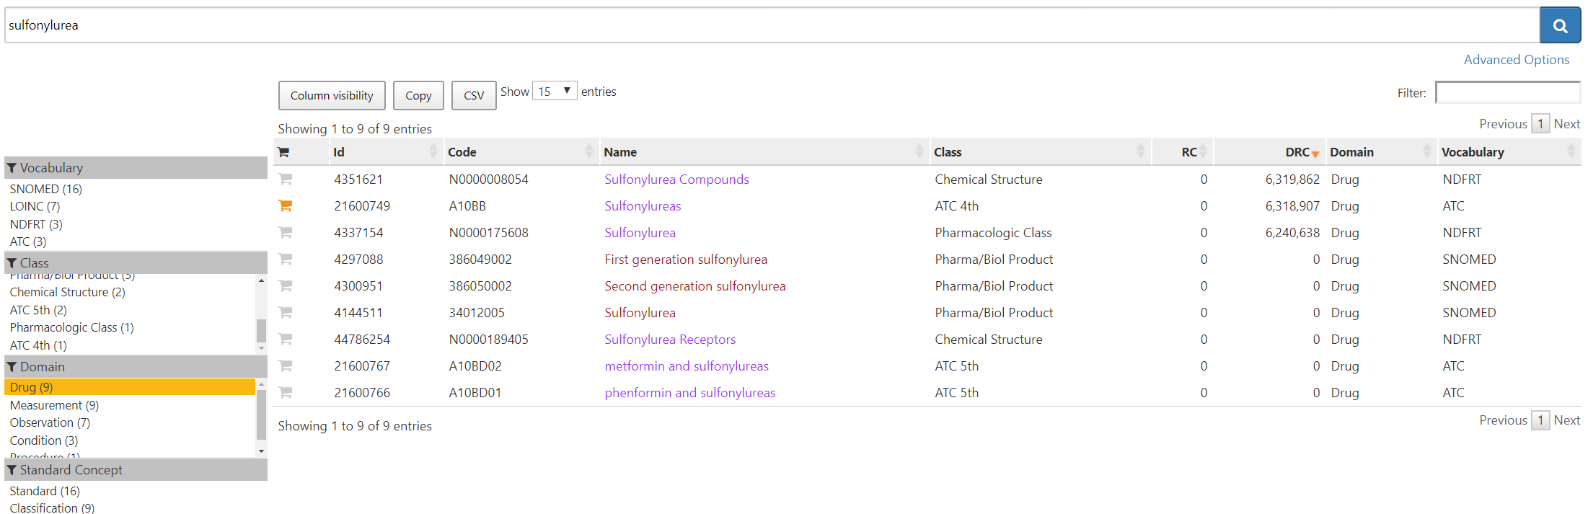
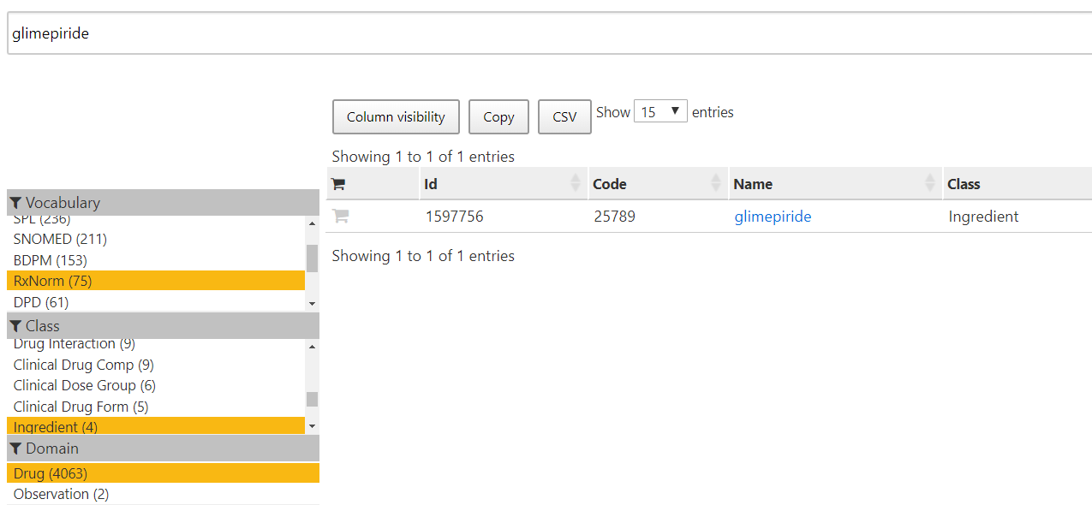
Making a concept set for SU
Sulfonylurea 계열 약물의 concept Ids를
단체로 선택 가능
약물 하나씩 선택 가능

Slide 9
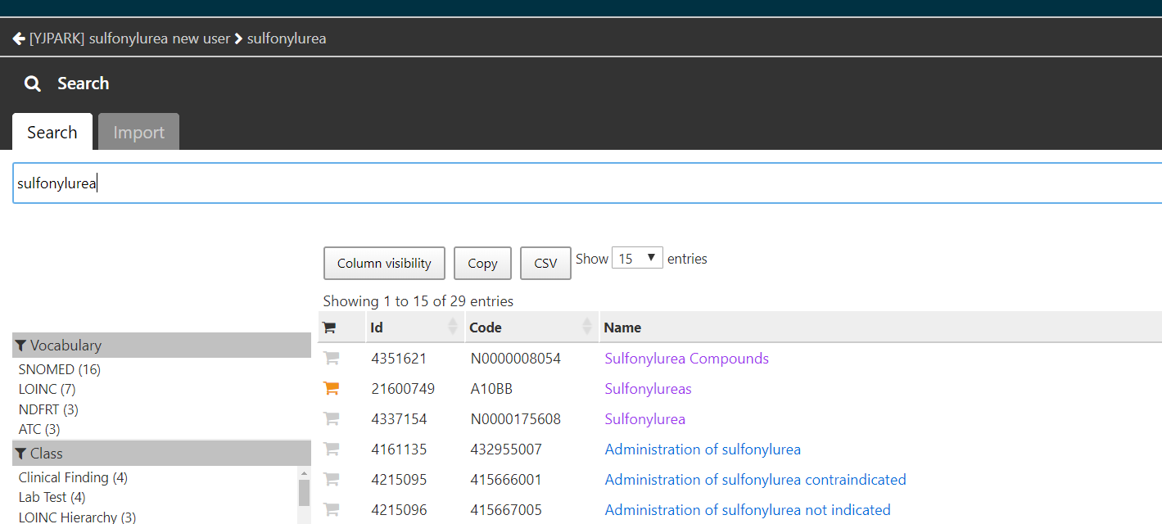
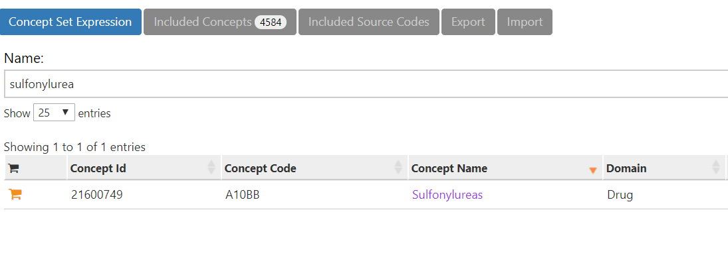
Making a concept set for SU

Slide 10
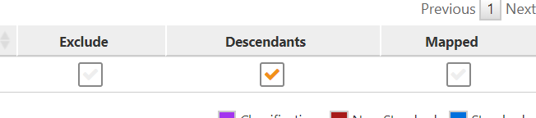
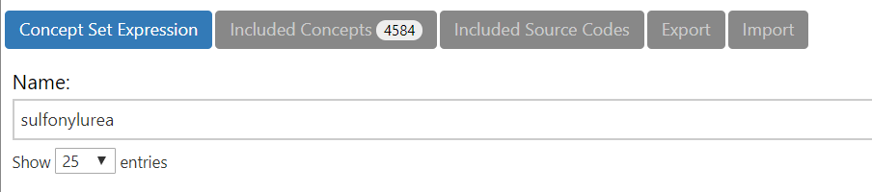
Making a concept set for SU
It is recommended that you check all included Concepts
하지만 실습에서는 included를 최대한 누르지 않도록 하자
Notes:
하나하나 concept이 맞게 들어갔는지 확인 하는게 추천되지만 ,. (아틀라스가 급속하게 느려 질 가능성이 있음)

Slide 11
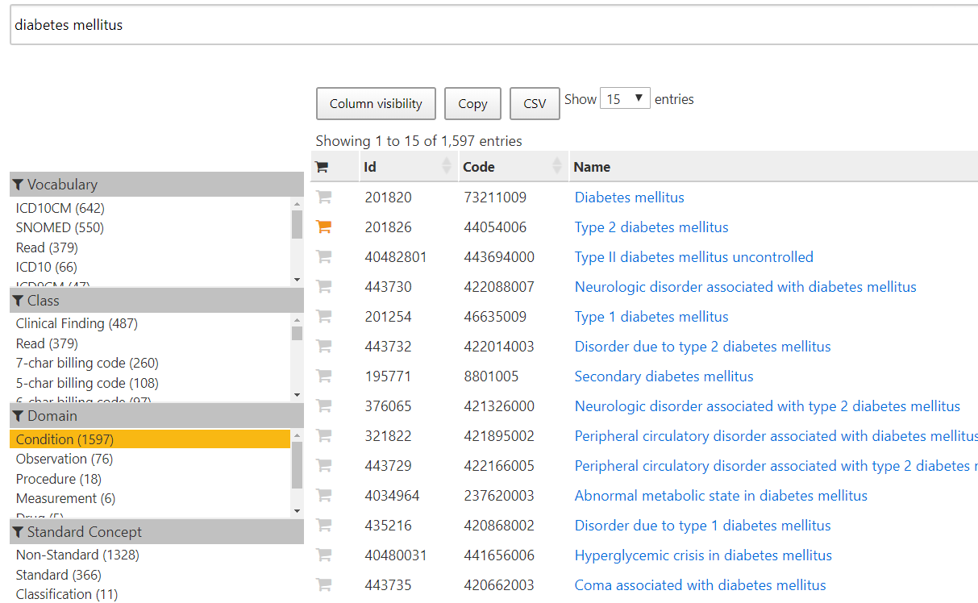
Making a concept set for T2DM
Notes:
하나하나 concept이 맞게 들어갔는지 확인 하는게 추천되지만 ,. (아틀라스가 급속하게 느려 질 가능성이 있음)

Slide 12
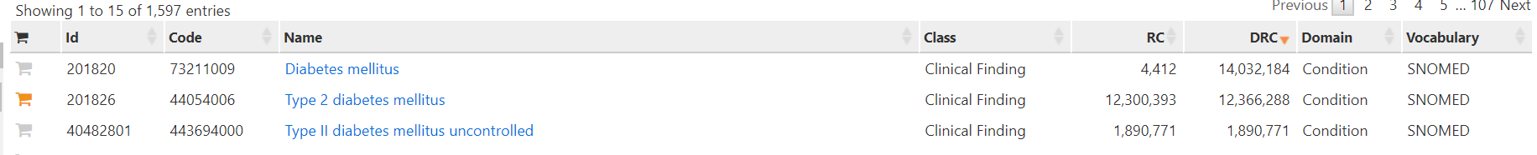
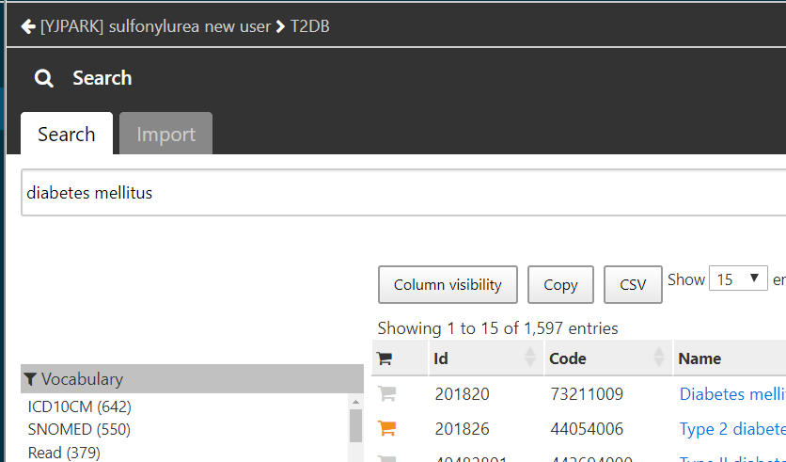
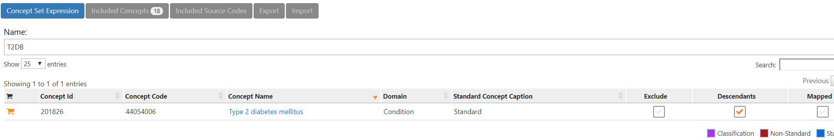
Making a concept set for T2DM

Slide 13
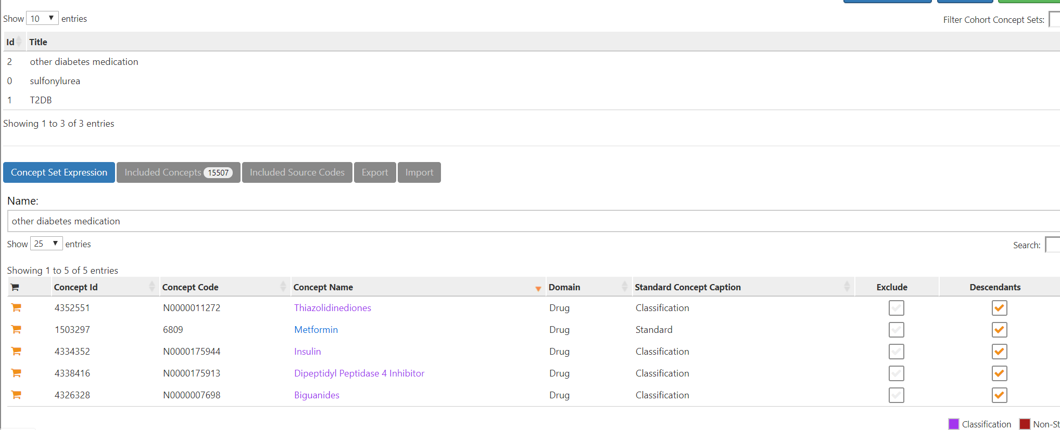
Making a concept set for other blood glucose lowering drugs
계열별로 선택해도 좋고
세심하게 하기 위해서는 약물 하나하나 선택하는 것도 좋다

Slide 14
Define cohort: Process flow for formally defining a cohort in ATLAS
Cohort entry criteria
Initial events
Events are recorded time-stamped observations for the persons, such as drug exposures, conditions, procedures, measurements and visits
All events have a start date and end date, though some events may have a start date and end date with the same value (such as procedures or measurements).
Initial event inclusion criteria
Additional qualifying inclusion criteria
The qualifying cohort will be defined as all persons who have an initial event, satisfy the initial event inclusion criteria, and fulfill all additional qualifying inclusion criteria
Each qualifying inclusion criteria will be evaluated to determine the impact of the criteria on the attrition of persons from the initial cohort
Cohort exit criteria
Initial cohort
Qualifying cohort

Slide 15
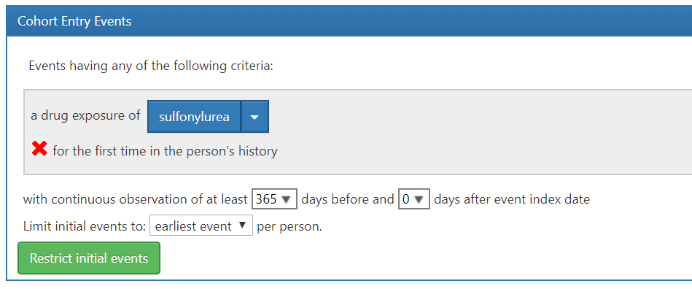
Sulfonylurea new user (initial event)

Slide 16
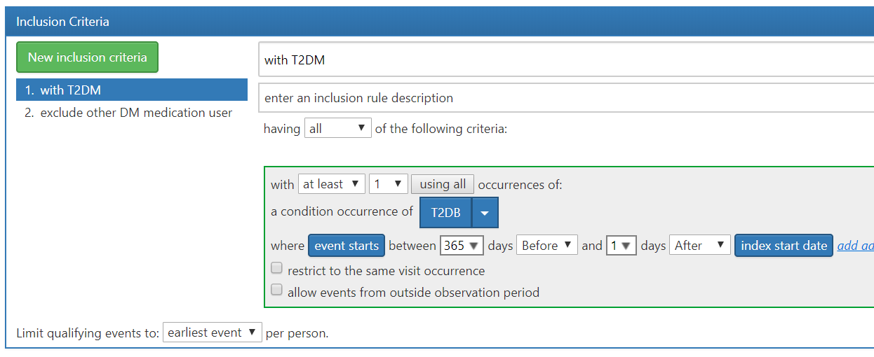
Additional inclusion criteria : patient with T2DM

Slide 17
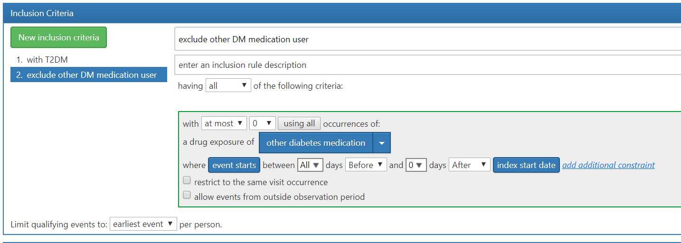
Additional exclusion criteria : other glucose lowering medication user

Slide 18
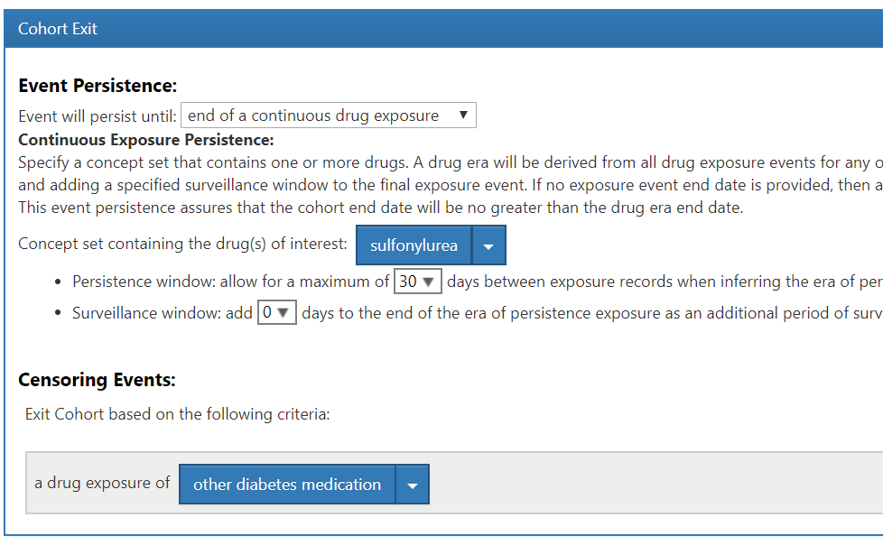
Cohort exit criteria and censoring event

Slide 19
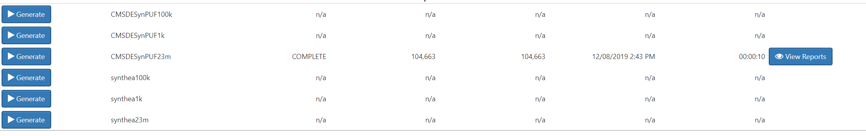
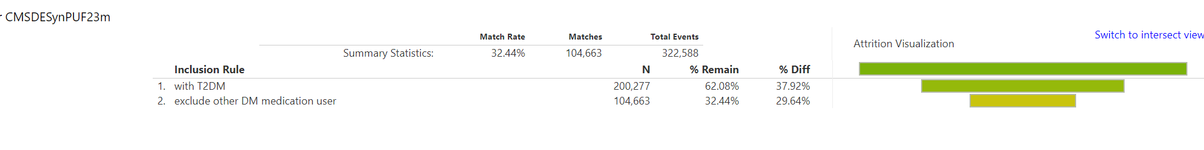
Generate target cohort
실습동안 SynPUF23m 에 대해서 Generate 누르지 말아주세요!

Slide 20
Outcome cohort
Choice | Value
Target population | Sulfonylurea 복용을 시작한 당뇨병 환자군
Outcome | Hypoglycemia 발생 환자군
Time At Risk (TAR) | 90일, 180일
Model | LASSO logistic regression

Slide 21
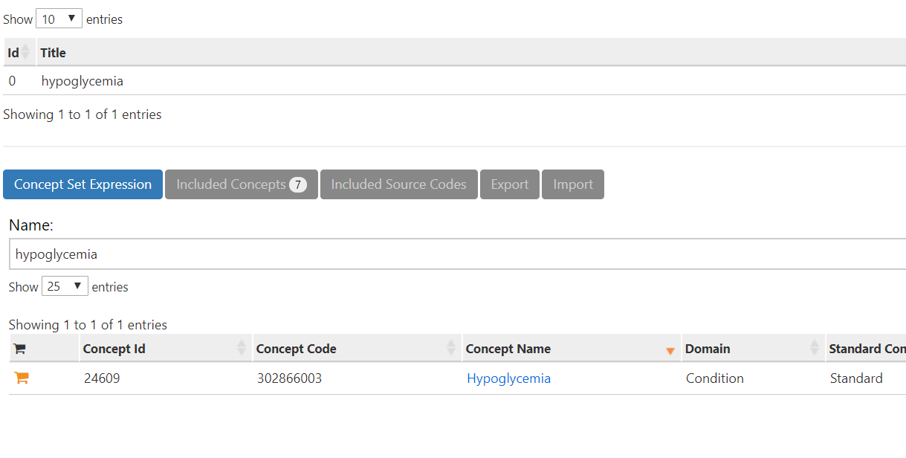
Make concept set

Slide 22
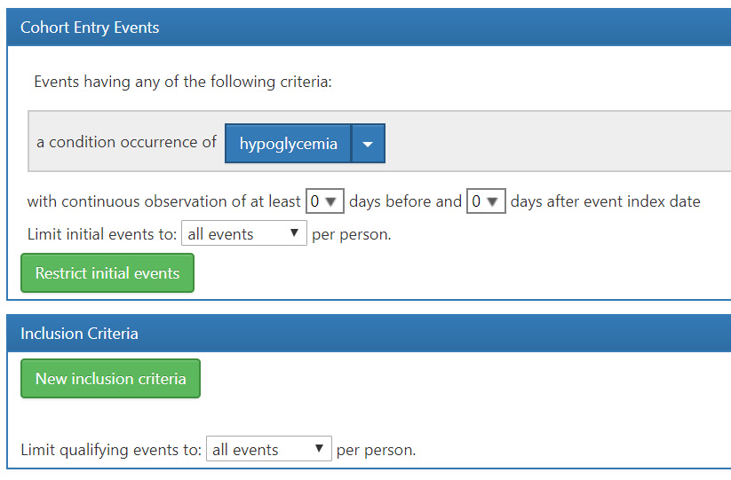
Hypoglycemia cohort cohort entry

Slide 23
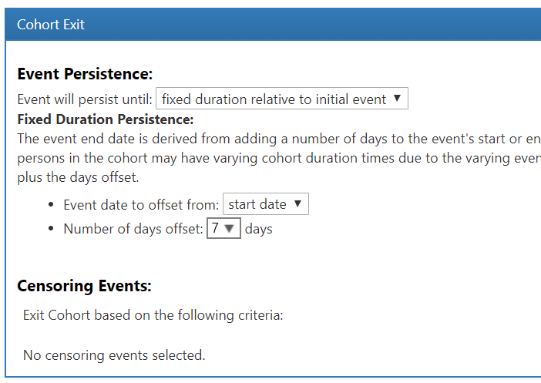
Hypoglycemia cohort cohort exit

Slide 24
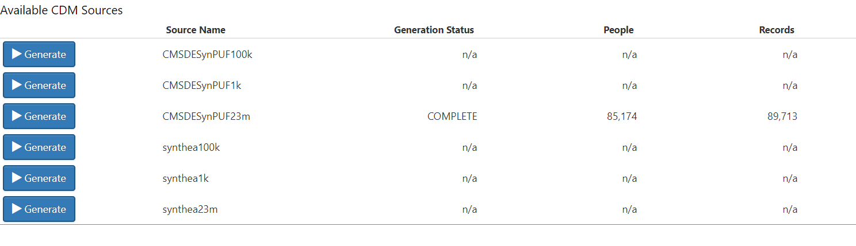
Generate target cohort
실습동안 SynPUF23m 에 대해서 Generate 누르지 말아주세요!

Slide 25
What evidence does OHDSI seek to generate from observational data?
Clinical characterization
Natural history: Who are the patients who have diabetes? Among those patients, who takes metformin?
Quality improvement: What proportion of patients with diabetes experience disease-related complications?
Population-level estimation
Safety surveillance: Does metformin cause hypoglycemia?
Comparative effectiveness: Does metformin cause hypoglycemia more than glyburide?
Patient-level prediction
Precision medicine: Given everything you know about me and my medical history, if I start taking metformin, what is the chance that I am going to have hypoglycemia during the first 30 days?
Disease interception: Given everything you know about me, what is the chance I will develop diabetes?

Slide 26
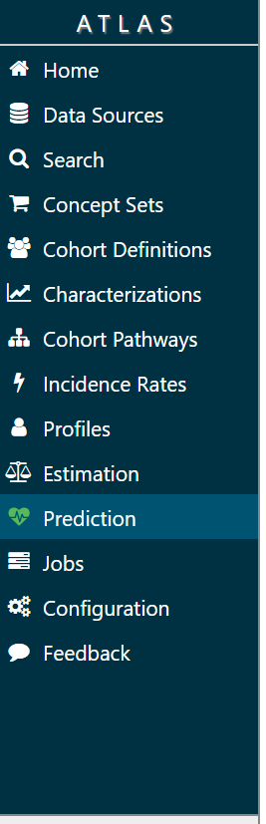
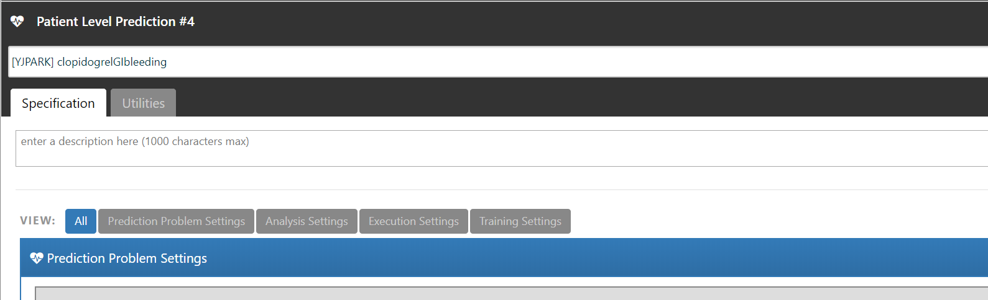

Slide 27
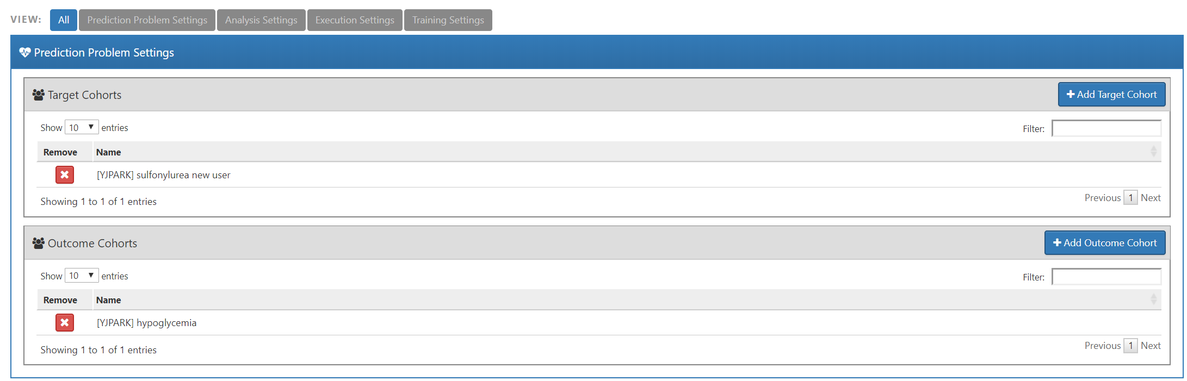
Patient Level Prediction: Prediction problem settings

Slide 28
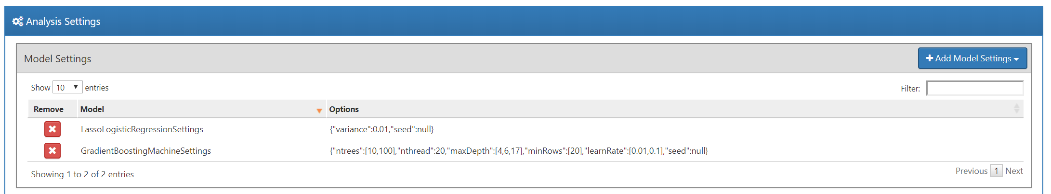
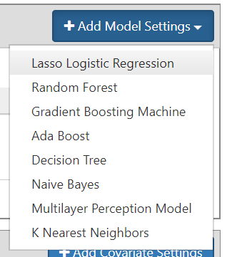
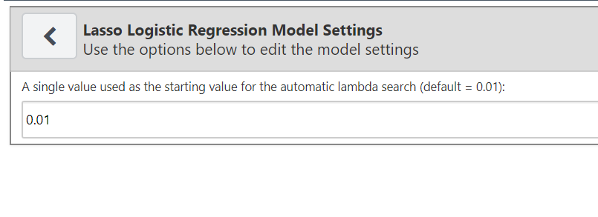
Patient Level Prediction: Model settings
Python environment was needed
Notes:
Lasso와 GBM이 현재의 상황에서 간단하게 실습 해 보기 좋은 모델이기 때문에 두개를 선택하는 것을 강력추천

Slide 29
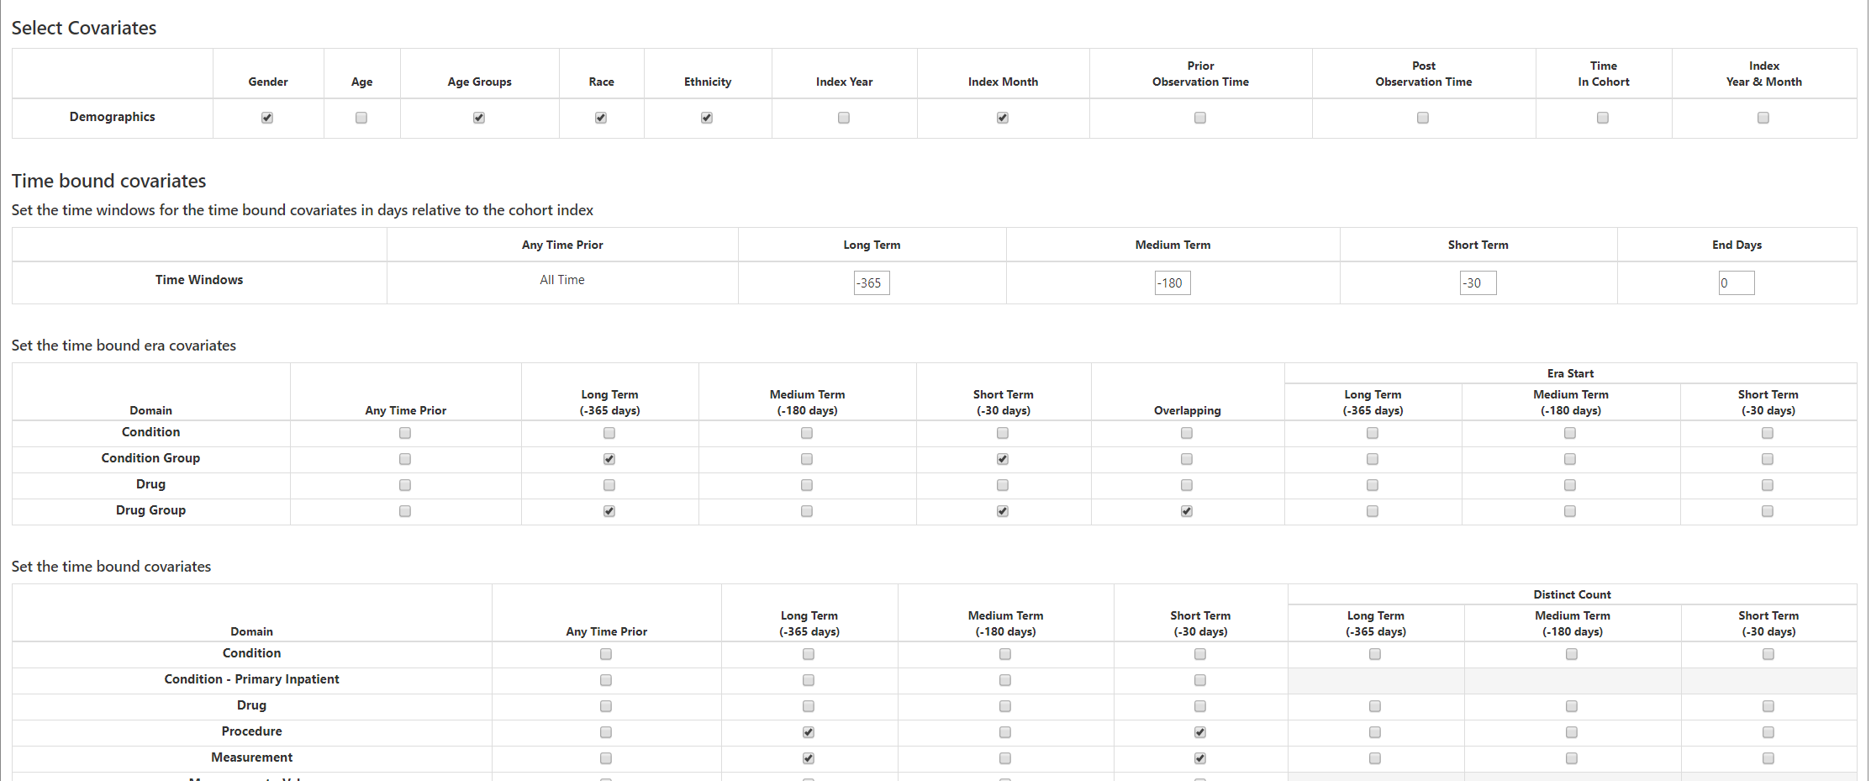
Patient Level Prediction: Covariate settings
Notes:
Lasso와 GBM이 현재의 상황에서 가장 실습 해 보기 좋은 모델이기 때문에 두개를 선택하는 것을 강력추천

Slide 30
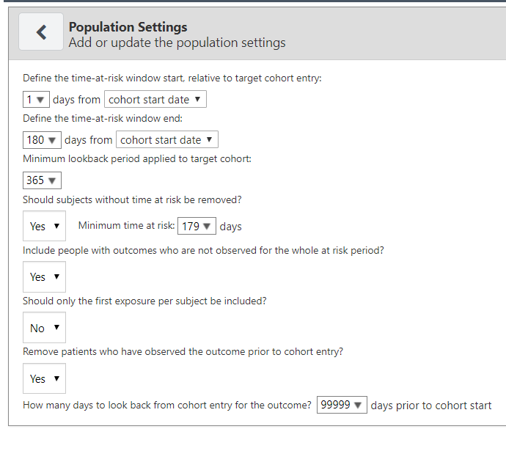
Patient Level Prediction: Population settings
Notes:
Lasso와 GBM이 현재의 상황에서 가장 실습 해 보기 좋은 모델이기 때문에 두개를 선택하는 것을 강력추천

Slide 31
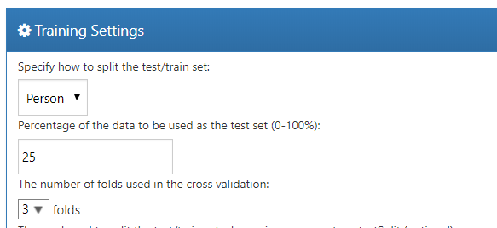
Patient Level Prediction: Training settings

Slide 32
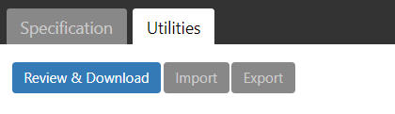
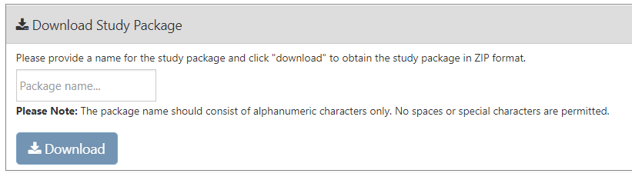
Patient Level Prediction: Training settings

Slide 33
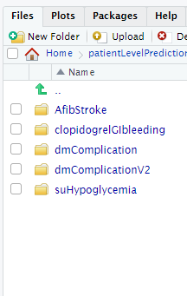
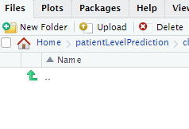
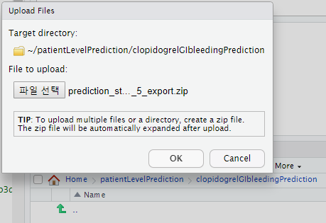
Running package 1. Upload package
1. Make a new folder
2. Get in the new folder and click upload
3. Upload the zip.file which downloaded before

Slide 34
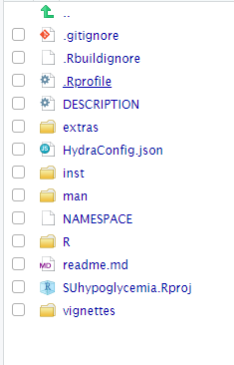
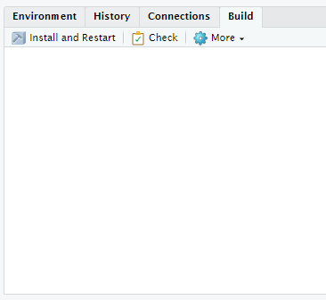
Running package 2. Install and Restart
4. Get in the new folder and click upload
5. Install and Restart

Slide 35
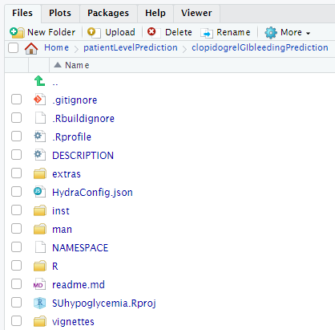
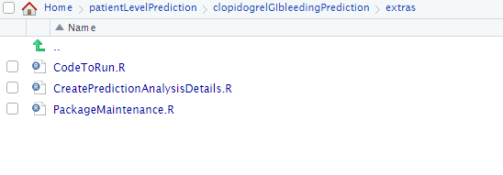
Running package 3. CodeToRun.R

Slide 36
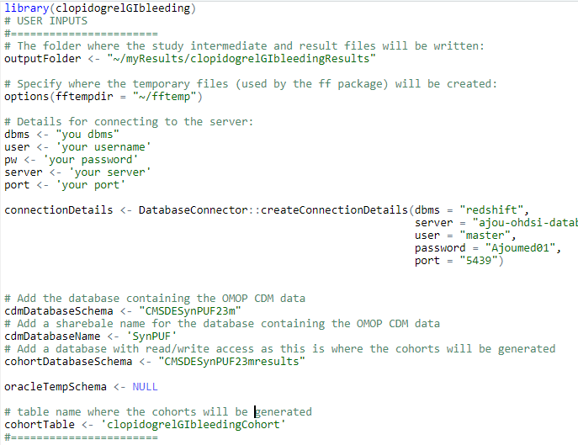
Running package 3. CodeToRun.R

Slide 37
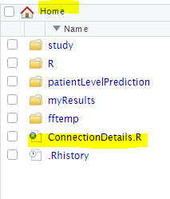
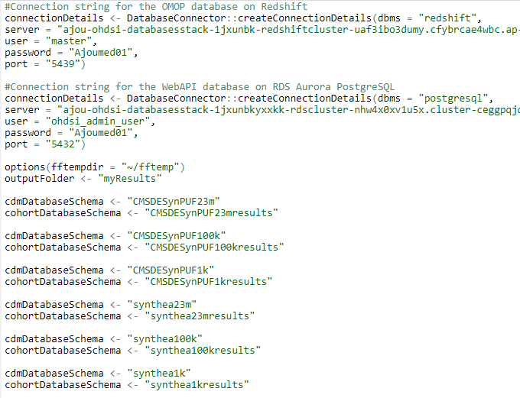
Running package 3. CodeToRun.R
“~/myResults/저장할 폴더 명”

Slide 38
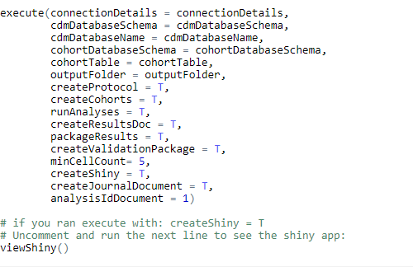
Running package 3. CodeToRun.R

Slide 39
Design your own prediction problem
Choice | Value
Target population | 예측을 하고자 하는 대상 환자군
Outcome | 예측하고자 하는 임상적인 결과
Time At Risk (TAR) | 예측 모델을 적용시키고자 하는 환자군에게서 예측하고자 하는 임상 결과를 관찰 할 시간 구간

